Slide 1



Titolo presentazione sottotitolo
Travlendar+
Milano, XX mese 20XX
Authors: A. Aimi, R. Bigazzi, F. Collini

Slide 2
Goals of the system
The aim of the system is to give the user the following functionalities:
registration to the service and preferences set up;
anytime management of personal and mobility preferences;
create and schedule a new event choosing time and location;
edit previously added event data;
change travel options on automatically created trips to/from event;
mobility companies’ tickets purchase via built-in browser;
provide high customizability of personal preferences regarding user daily routines.

Slide 3
Goals of the system
and to provide on its own these other ones:
manage in a clever way trips to/from user events, relying on the map of the surroundings, time of the day, public and private transports’ timetables and stops, shared means, traffic, weather forecast, possible strikes, event information and user preferences;
notify the user on time of upcoming trips;
warn him in case of an exception.

Slide 4
Boundaries

Slide 5
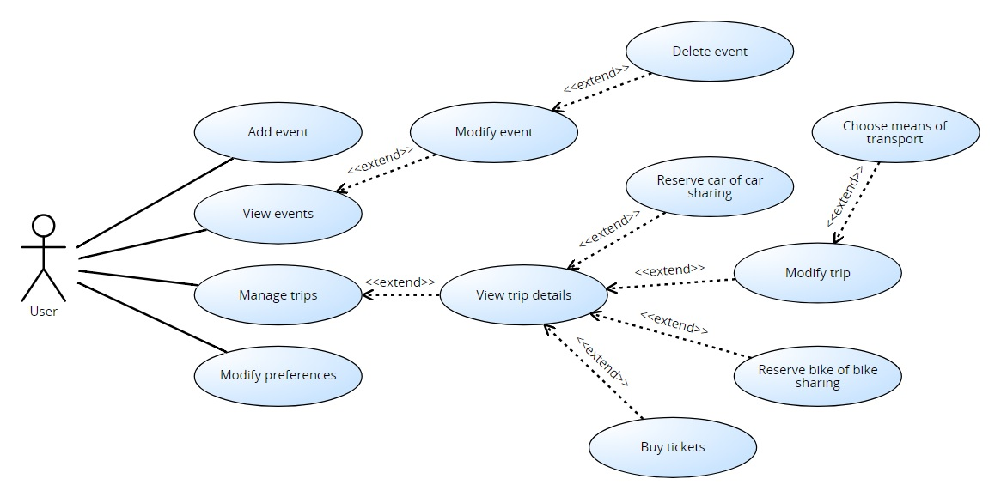
Use Case

Slide 6
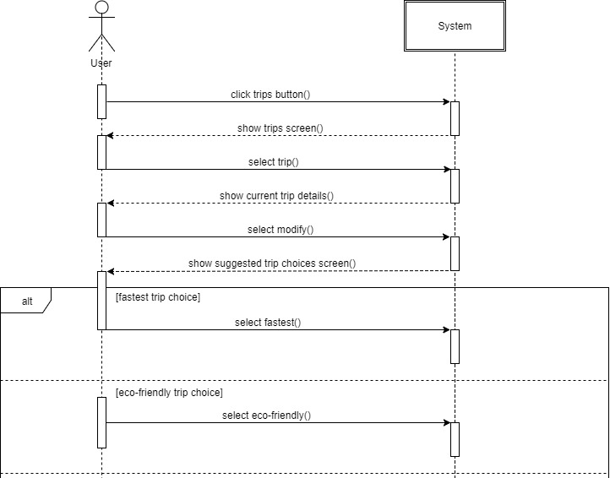
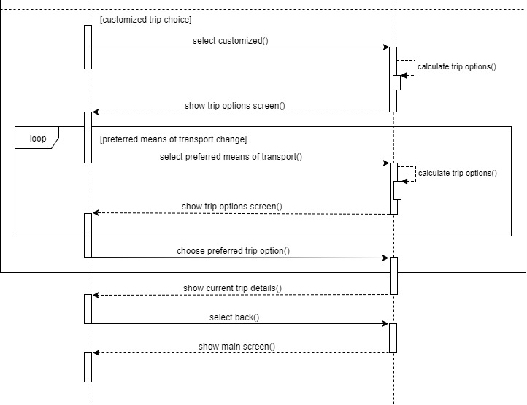
Use Case

Slide 7
Requirements
These are some significant requirements about choices we made in the system conception:
Functional requirements:
The user can set the presence of passengers in every trip;
The system will warn the user of overlapping events creation and will ask to choose the primary event to keep in consideration for trip planning.

Slide 8
Requirements
Interface requirements:
On the calendar main screen, the user can press the “Trips” button on the bottom left side of the screen (the light blue one with a plane on it) and the main screen will change to show the trips and all the events will become black and white.
Performance requirements:
Trips solutions are updated daily until the day of the trip, then every hour until half an hour before the trip, finally every minute until the trip begins.

Slide 9
Assumptions
We suppose that the following conditions are true in the analyzed world:
the geographical area of the city is included in the coverage area of most common mobile communication technologies (3g, 4g) offered by main telecommunications companies;
users must be subscripted to a sharing service if they want to use it;
APIs used by the application will always be updated on traffic status, eventual incidents and weather conditions;
sharing services’ APIs signals their means if and only if the means are where the APIs say, and they are not occupied or booked;
users always have a working internet connection;
half an hour is enough warning time for users to start a trip;
the user cannot ride two means of transport at the same time.

Slide 10
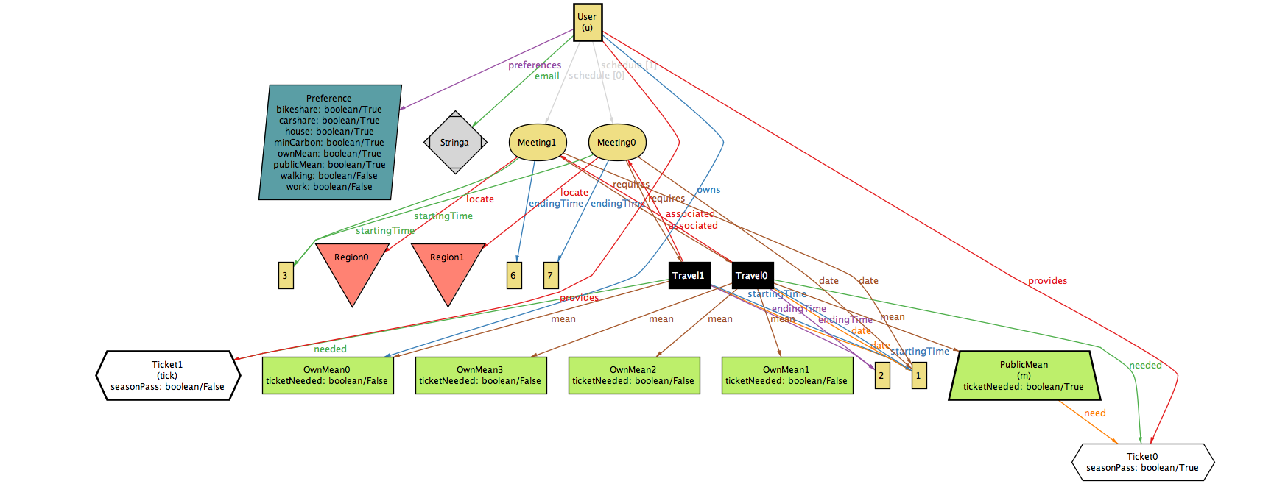
Alloy
Describe domain and properties plus the operations that the machine has to provide to formally model our system.

Slide 11
Constraints
//Users will travel on mean they could take
fact noUnauthorizedMean{
all u: User, t: Travel | u.owns in t.mean || u.subscribed in t.mean ||
u.provides in t.needed
}
//Travels associated to a meeting for a user must start at different times
fact travelsStartAtDifferentTime{
no disj t1, t2: Travel | one m: Meeting | m in t1.associated && m in t2.associated
&& t1.startingTime=t2.startingTime && t1.endingTime=t2.endingTime
}

Slide 12
Constraints
//Any Travel needs at least one mean of transport
fact AtLeastOneMeanForTravel {
some m: MeanOfTransp | some tick:Ticket | all t: Travel |
m in t.mean || tick in t.needed
}
//Travel must be compatible to what the user owns or provides
fact TravelCompatibleToUser{
all t: Travel | all u: User | all i: u.schedule.inds | t in u.schedule[i].requires =>
((some m: t.mean | m in u.schedule[i].requires.mean) ||
(some tick: Ticket | tick in u.schedule[i].requires.needed))
}

Slide 13
Assertions
assert addChangesSchedule
{
all u1, u2: User, m: Meeting | #u1.schedule = #u2.schedule && (u1.addMeeting[u1, m] => #u2.schedule < #u1.schedule)
}
assert deleteInverseOfAdd
{
all u: User, m: Meeting, s: u.schedule | u.addMeeting[u, m] and u.deleteMeeting[u, m] => s = u.schedule
}

Slide 14
Assertions
assert oneTravelAtATime
{
no u: User | one disj t1, t2: Travel | all i: u.schedule.inds | t1 in u.schedule[i].requires
&& t2 in u.schedule[i].requires && t1.date=t2.date
&& (t1.endingTime>t2.startingTime || t2.endingTime>t1.startingTime)
}

Slide 15
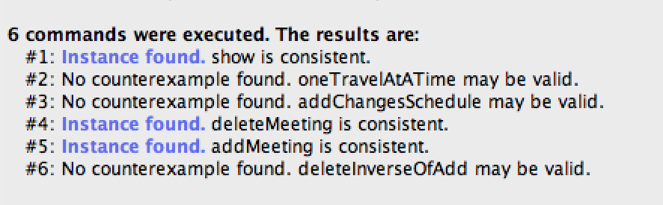
Results
And we will get:

